Slide 2
Revelation 1:19
Write the things which you have seen, and the things which are, and the things which will take place after this.

Slide 3
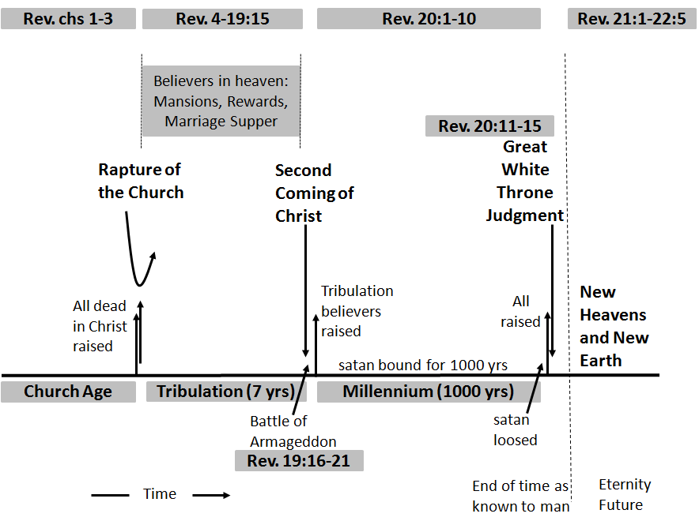

Slide 4
Chapter 1 : The Revelation of Jesus Christ

Slide 5
Chapters 2 & 3 : The Seven Churches

Slide 6
Chapter 4 & 5 : The Throne Room & Worship in Heaven

Slide 7
Chapter 6 : The First Six Seals

Slide 8
Chapter 7 : The 144,000 Jews And The Great Multitude of Martyrs

Slide 9
Chapter 8 : Silence in Heaven And The First Four Trumpets

Slide 10
Chapter 9 : The Fifth And Sixth Trumpets

Slide 11
Chapter 10 : The Mighty Angel And The Little Book

Slide 12
Chapter 11 : Two Witnesses & Seventh Trumpet

Slide 13
The Two
Witnesses

Slide 14
Chapter 12 : The Woman, The Man Child And The Dragon

Slide 15
Chapter 13 : The Two Beasts

Slide 17
Chapter 14 : A Great Harvest Time

Slide 18
Chapter 15 : Prelude To The Bowl Judgments

Slide 19
Chapter 16 : The Seven Angels And Seven Bowls of Wrath

Slide 20
Chapter 17 : The Great Harlot Babylon
(A Worldwide Religious System)

Slide 21
Chapter 18 : The Fall of Babylon the Great
(An Economic/Political System)

Slide 22
Chapter 19 : The Second Coming of Christ And The Battle of Armageddon

Slide 24
Chapter 20 : The 1000 Year Reign of Christ And Final Judgment

Slide 25
Chapter 21 : The New Jerusalem

Slide 26
Chapter 22 : River of Life
& Jesus’ Soon Coming

