Slide 2
2 Corinthians
chapters 8 & 9

Slide 3
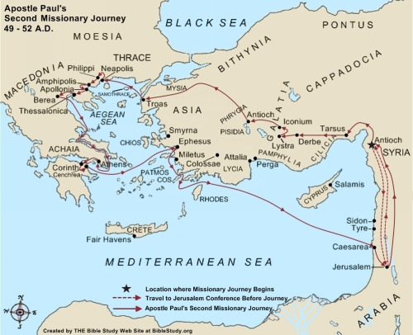

Slide 4
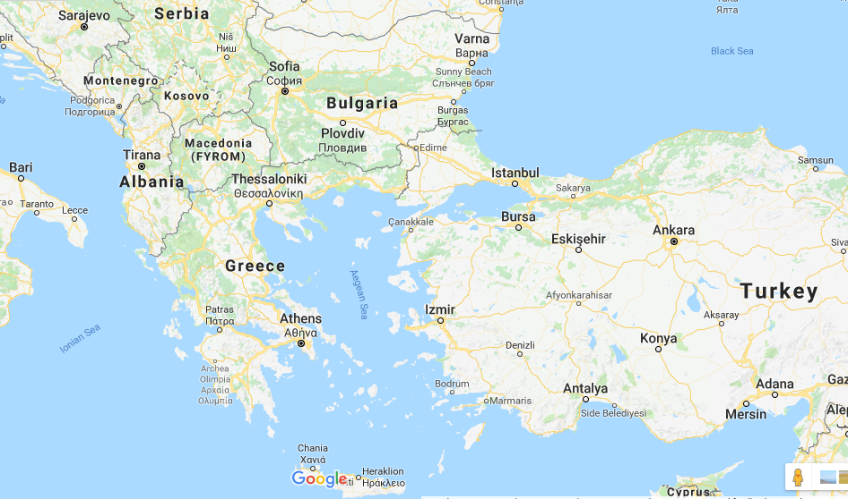

Slide 5
2 Corinthians 8:1
The churches of Macedonia
believers at Philippi, Thessalonica and Berea
and possibly those at Neapolis, Amphipolis, Apollonia

Slide 6
2 Corinthians 8:1
Generosity, or our ability to give
is really a grace bestowed on us.

Slide 7
2 Corinthians 8:5
Our giving must be an expression of our surrender to God.

Slide 8
2 Corinthians 8:5
Our giving must be according to
what God wants us to do,
an expression of His purposes through us.

Slide 9
2 Corinthians 8:7
"...see that you abound in this grace also."

Slide 10
2 Corinthians 8:8
"I speak not by commandment..."

Slide 11
2 Corinthians 8:21
"providing honorable things, not only in the sight of the Lord, but also in the sight of men"

Slide 12
2 Corinthians 9:5
We give as a matter of blessing others,
as when making an eulogy,
and not as though we are being
extorted or forced into this because of someone's greediness.

Slide 13
2 Corinthians 9:6
Sowing, when done properly,
always results in multiplication!

Slide 14
2 Corinthians 9:7
give as you purpose in your heart
give cheerfully
do not give grudgingly
do not give out of compulsion

Slide 15
2 Corinthians 9:10-11
God…
…supplies seed to the sower
…provides bread to the eater
…multiplies the seeds we sow and increases the fruits
…enriches us to all liberality

Slide 16
Philippians 4:15-19

Slide 17
Philippians 4:17
Expect to receive blessings
that come from you giving.

