Slide 2
"Revival is a community saturated with God"
(Duncan Campbell,
Hebridean Revival of 1949-1952)

Slide 3
1727 The Moravian Revival and Count Zinzendorf

Slide 4
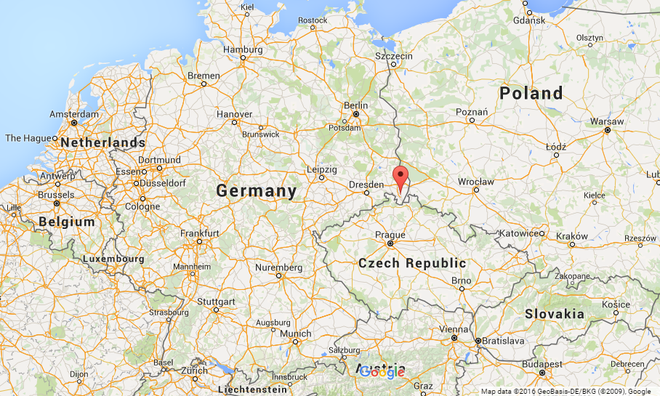
1727 The Moravian Revival
and Count Zinzendorf
Herrnhut, Germany August 13, 1727

Slide 5
1800 The Second Great Awakening in North America
Revival in Logan County, Kentucky, June 1800
Revival in Cane Ridge, Kentucky, August 6, 1801
Revival on College Campuses

Slide 6
1857 The Laymen's Prayer Revival, New York
Jeremiah Lanphier

Slide 7
1905 Mukti Mission Revival and Pandita Ramabai

Slide 8
Preparing our hearts to pray for revival

Slide 9
Preparing our hearts to pray for revival
2 Chronicles 7:14
if My people who are called by My name will humble themselves, and pray and seek My face, and turn from their wicked ways, then I will hear from heaven, and will forgive their sin and heal their land.

Slide 10
Preparing our hearts to pray for revival
Hosea 10:12
Sow for yourselves righteousness; Reap in mercy; Break up your fallow ground, For it is time to seek the LORD, Till He comes and rains righteousness on you.

