Slide 1
2016 15 Years of Journeying Together with God

Slide 2
APC is not the work of a man, or an organization or denomination. We are a work of the Holy Spirit through ordinary people.

Slide 3
We now move from being an EQUIPPING church to being a PIONEERING church

Slide 4
We EQUIP to PIONEER

Slide 5
What does it mean to PIONEER?
to do things that have not been done before
to go where no one has gone before
to step into unchartered territory and break new ground
to do things that are new, innovative and creative
to break past barriers and limitations

Slide 6
“Pioneers have the ability to advance ahead of the others to instill greater confidence into the heart of the rest of the Body of Christ who are following behind. Their forward advancement opens up new doors for effective service for the Church. Their ministry provides a cutting edge to influence and impact society”
(Dr. Jonathan David)

Slide 8
Every visitation of God should become a habitation of God and become a move of God released through the church into the community and world.

Slide 9
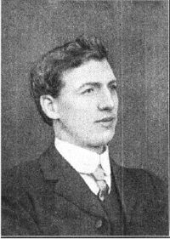
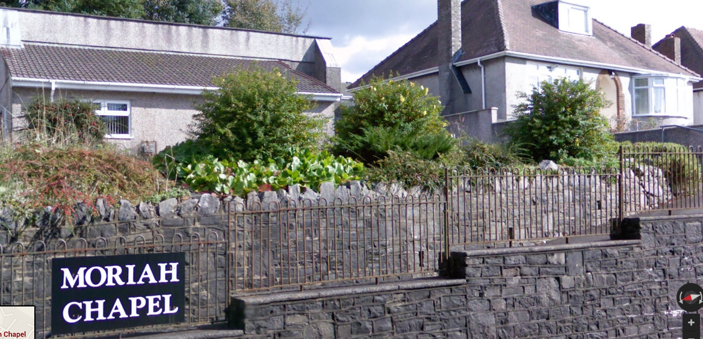
The story of the 1904 Welsh Revival
and Evan Roberts

Slide 10
Separating The Wheat from The Chaff
Matthew 13:24-30

Slide 11
Stewarding A Visitation Into A Habitation of God
Keep the house clean - no sin in the house
Keep the unity of the Spirit - God finds this good and pleasant

Slide 12
Stewarding A Visitation Into A Habitation of God
Keep a humble heart - God resists the proud
“Bend the Church, and save the world” –Evan Roberts
Keep Him as the focus - He is the Lord over His own House

Slide 13
Stewarding A Visitation Into A Habitation of God
Continue to maintain prayer that fuels revival
Stay with what is important

Slide 14
Stewarding A Visitation Into A Habitation of God
Provide a Biblical perspective on what is happening
Create and maintain revival culture to sustain revival

Slide 15
Stewarding A Visitation Into A Habitation of God
Take care of the people
Guard what has been committed from human or demonic attacks

Slide 16
Stewarding A Visitation Into A Move of God
Share the story to inspire others
Find people who are ready to catch the fire.

Slide 17
Stewarding A Visitation Into A Move of God
Impart in the spirit - not necessarily the 'methods' or 'way of doing things‘
Transfer key elements of the visitation, but let God work as He desires

Slide 18
Stewarding A Visitation Into A Move of God
Release carriers of revival to take revival fires far and wide

Slide 19
It's Our Turn Now!
The Nations Are Waiting

