Slide 2
The exercise of SPIRITUAL GIFTS
and the different FUNCTIONS in the body

Slide 3
Concerning Spiritual Gifts (12:1-11)
vs 1:
'spiritual' (Greek 'pneumatikos')
means 'non-carnal', 'supernatural'.

Slide 4
Concerning Spiritual Gifts (12:1-11)
God wants us to know,
understand and exercise
spiritual gifts

Slide 5
Concerning Spiritual Gifts (12:1-11)
vs 4:
'gifts' in Greek is 'charisma'
means a 'gift of grace‘
'charis' means 'grace'

Slide 6
Concerning Spiritual Gifts (12:1-11)
vs 5:
'ministries' in Greek is 'diakonia'
meaning 'services', 'offices'

Slide 7
Concerning Spiritual Gifts (12:1-11)
vs 6:
'activities' in Greek is 'energēma'
meaning
'workings',
'outward manifestations',
'effects'

Slide 8
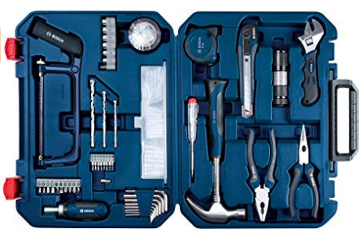
Concerning Spiritual Gifts (12:1-11)
vs 6:
GIFTS, MINISTRIES, OPERATIONS
electrician, plumber, carpenter, auto-mechanic

Slide 9
Concerning Spiritual Gifts (12:1-11)
vs 6:
THE SAME GIFTS OF THE SPIRIT CAN BE EXPRESSED IN DIFFERENT WAYS THROUGH VARIOUS MINISTRIES IN THE BODY OF CHRIST

Slide 10
Concerning Spiritual Gifts (12:1-11)
vs 7:
EVERY BELIEVER
CAN HAVE THE GIFTS OF THE SPIRIT
(OR MANIFESTATIONS OF THE SPIRIT)
RELEASED THROUGH HIM OR HER

Slide 11
Concerning Spiritual Gifts (12:1-11)
vs 8-10:
word of wisdom
word of knowledge
faith
gifts of healings
working of miracles
prophecy
discerning of spirits
different kinds of tongues
interpretation of tongues

Slide 12
Functions In The Body (12:12-27)
A, The Body has many members (12:12,14)
B, Each one of us is a member of the Body (12:27)

Slide 13
Functions In The Body (12:12-27)
C, We are not independent. We need each other (12:15,16)
D, There are diverse functions in the Body (12:17)

Slide 14
Functions In The Body (12:12-27)
E, God has placed each one where He saw it best for us and as He was pleased (12:18)
F, It takes many of us - all of us - to make up the whole (12:19,20)

Slide 15
Functions In The Body (12:12-27)
G, We can never claim independence (12:21)
H, God gives greater honor to what seems to have less honor (12:22-24)

Slide 16
Functions In The Body (12:12-27)
I, God does not want any division/strife in His Body, but that we demonstrate mutual love and care for one another (12:25-26)

Slide 17
Functions In The Body (12:12-27)
Gifts And Functions

Slide 18
Functions In The Body (12:12-27)
Gifts Of The Spirit, Membership Gifts And Ministry Gifts

Slide 19
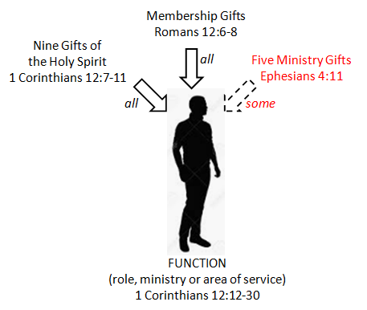
Functions In The Body (12:12-27)

Slide 20
Different Ministry Functions
(12:28-30)
'has appointed' meaning, to put in place for His own use
'first' (Greek 'proton') meaning first in time or place, or first in rank, influence, honor

Slide 21
Different Ministry Functions
(12:28-30)
'helps' referring to those who render any kind of aid, assistance, service or help; helpers
'administrations' in KJV 'governments',
meaning 'to govern' or 'rule' and is usually applied to the one steering a ship

Slide 22
Earnestly Desire (12:31)
1 Corinthians 12:31
But earnestly desire the best gifts. And yet I show you a more excellent way.

Slide 23
The More Excellent Way
WHATEVER WE DO WE
MUST BE GOVERNED, GUIDED
AND MOTIVATED BY
THE GOD-KIND OF LOVE

Slide 24
The More Excellent Way
WALK IN LOVE
DESIRE SPIRITUAL GIFTS
STEP OUT IN FAITH

